Slide 1
Introduction to the SSRMP
Dr Mark Ramsden (Director)
Siobhan Hoffmann Heap (Chief Administrator)
Dr Matthew Sparkes (Teaching Associate)

Slide 2
SSRMP, the pandemic & social distancing
All SSRMP modules during Michaelmas Term will be undertaken remotely
- please check on the Moodle page for each module for provision details
We are not yet sure how provision will be taught be taught in Lent Term but we are planning for it to consist of a mixture remote and in-situ provision
- we will update our website once we know for sure

Slide 3
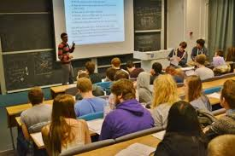
What we do
Provide training in research methods
Focus on social sciences, but students from many departments attend
Staff are welcome!
External participants are welcome (at a reasonable cost)
Exceptional undergraduates may attend by special arrangement
Provide a wide selection of modules
All information on our website
http://www.ssrmp.group.cam.ac.uk/

Slide 4
What we don’t do
Provide one-to-one teaching
Our teachers may see you individually if you have questions relating to the module
But our resources are extremely limited
Advise on the implementation of methods for your own thesis
Your own department MUST provide a supervisor who can help you
Issue proof of attendance

Slide 5
Two types of module
Core modules
Basic Statistics Stream
Our most popular modules
Quantitative methods of data analysis
Several repeats of the first 3 modules in the series
Introduction to Software Packages
Stata, R, Matlab, Python, Microsoft Access
Elements of Social Science Research
Specialist Statistics modules
Qualitative Methods
Open access modules (see website, ‘Other modules’)
Taught in individual departments
Not specially geared to a multidisciplinary audience, but may be of general interest
Contact the relevant department to book a place

Slide 6
Priority
A “waiting list” system operates for oversubscribed modules
Students for whom the module is compulsory
First come first served - Cambridge
External participants

Slide 7
How to choose your modules
Some are compulsory
Some are recommended for your degree course
Others according to your interests/intentions/career
Many students actively choose to diversify – ESRC guidelines
Your dissertation/thesis: PLAN AHEAD!
Fieldwork/interviewing?
Analytical methods: qual/quant?
Software packages?
Talk to your supervisor
Think one step ahead,
- don’t leave to term/final year
to your next paper or project

Slide 8
Basic Statistics Stream – Skill Check
To book for Basic Statistics Stream courses, you must
EITHER have taken the Skill Check
OR have passed the exam for the previous module in the stream
To assess your existing competence and tell you which of our Basic Statistics Stream modules is a good starting point
Will not affect your degree grade
If your result is ambiguous, you will need to talk to your supervisor
Take the test: http://www.ssrmc.group.cam.ac.uk/skill-check
Open book test, but nothing to be gained from “cheating”
PLEASE EXIT PROPERLY – CLICK “SUBMIT”

Slide 9
Our basic stats courses
SKILL CHECK
Foundations in Applied Statistics
(FIAS)
Basic Quantitative Methods
(BQA)
Doing Multivariate Analysis
(DMA)
Further Topics in Multivariate Analysis
(FTMA)
All our stats modules are “hands-on”, using real data
They are taught in computer labs, using statistical packages for data analysis

Slide 10
Our basic stats courses
Foundations in Applied Statistics
Basic Quantitative Methods
Doing Multivariate Analysis
Further Topics in Multivariate Analysis
Taught in Stata - introduction provided
Taught in Stata – some prior knowledge assumed
If you’re entering at BQA, DMA or FTMA and have not used Stata:
Ask to attend the first FiAS lab session (if there are spaces)
Work through “90-minute Stata” Moodle course and worksheets for FIAS
Take Introduction to Stata module

Slide 11
Managed cluster machines
Stata, SPSS and other software packages are available in UIS Managed Cluster machines in:
Titan Rooms, Phoenix Rooms, University Centre Mill Lane (when these rooms aren’t booked for classes)
Managed clusters in POLIS, Education, Geography, History, Land Economy, some other Departments (check with your department)
In most Colleges
In some Libraries
To log in to the workstations you will need:
Login: your university CRSid (e.g. mjr60)
New students: your “combined UIS password”
Old students: your Desktop Services password (NOT your Raven password)
If you do not have a password, ask the University Information Service helpdesk ** BEFORE START OF MODULE **

Slide 12
DS-REMOTE
DS-Remote provides remote access (from anywhere in the world) to the University’s managed cluster machines
Desktop Services
£5 per month for all the software packages you use
DS-remote is only for students
The SSRMC won’t pay, but if you don’t want to pay there are many other ways to use the MCS machines
Register here: http://www.ucs.cam.ac.uk/desktop-services/ds-remote

Slide 13
End-of-module tests
Most quantitative modules are assessed via online multiple choice tests
Most qualitative modules are not assessed
Tests are compulsory for some students, not for others
Should YOU take the test?
Ask your Department, not the SSRMC
If your course is compulsory, so is the assessment
To progress to the next module in Basic Stats, you must take the test
We recommend that all students take the end-of-module test
For quantitative modules, no proof of attendance without taking the exam

Slide 14
Feedback
Your feedback is very important to us
Helps us improve provision
By booking an SSRMC module you agree to provide feedback
An email with a link will be circulated shortly after your last session
After that you will get regular reminders……
Please don’t ignore the reminders
If you didn’t finish the module, you can respond to that effect
You will not be able to get proof of attendance unless you provide feedback
Your feedback is treated confidentially and will be anonymised

Slide 15
Moodle
Most SSRMC course materials are hosted on Moodle (SSRMC is under “Staff and Student Training”)
https://www.vle.cam.ac.uk/login/index.php
After booking your module via the SSRMC website [more to follow] please enrol yourself on the Moodle page for that module, in order to access the course materials

Slide 16
Bookings
You must make a booking for every module that you take
Even if the module is taught by someone who works in your own Department
Bookings are made the SSRMP website “make a booking”
Bookings open Thursday 8th October, 6pm
Before you book… check your Department timetable and ensure you have your Raven / CRSID password

Slide 17
How the booking system works
Book all modules via the SSRMP website
“Core modules” list on the “modules” tab
Clicking a module name takes you through to the module description and the booking portal (left-hand side)
Basic Statistics Stream modules – request a booking via the dedicated form
Please request bookings for ALL Basic Stats modules you want to attend
Indicate ALL the times you are available to attend
Enter your Skill Check scores (or assessment results from last year)
We will contact you with details of module times
Open Access modules – contact the relevant department

Slide 19
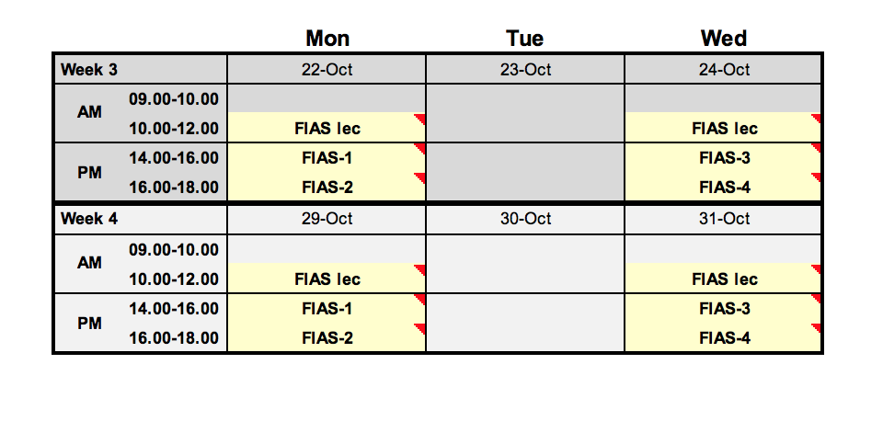
About the Basic Statistics modules
8 hours of instruction
4 hours over 2 weeks
2 hours lectures in the morning
2 hours of lab sessions in the afternoon, split into two groups
Only attend one of the lab sessions
OR (intensive) 8 hours over one day
“catch-up” sessions in Lent term; attend in Michaelmas if possible
If you can’t attend a lecture, you can view it online

Slide 20
Oversubscribed modules
Very rare.
If you try to book a module which is oversubscribed, you will get a message saying you’re on the waiting list.
If you later get a place on the module, you will be notified by email.
Non-priority departments may be “downgraded”.
If you book and decide not to attend, please cancel the booking ASAP, so someone else can go.
You may get a reminder a week or two before the module begins, asking you to confirm that you still want the place.

Slide 21
Cancelling a booking
Can only be done BEFORE the first session of a module
Cancellations are done on via the SSRMC website
If possible, please cancel 2 full working days before the module starts

